Slide 1
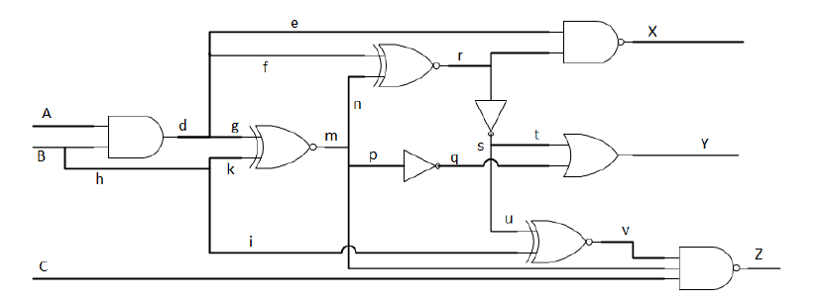

SS@0
PODEM
d – SS@0
EE658 – Diagnosis and Design of Reliable Digital Systems
Professor Tabar
Fei Wu

Slide 2
PODEM()
SS@0
All initial values are considered X, including the faulty node.

Slide 3
Objective()
SS@0
Fault: AND_d SS@0, current value of AND_d = X
Objective: {AND_d, 1}

Slide 4
Backtrace(AND_d, 1)
D
D
SS@0
D
1
D

Slide 5
Backtrace(AND_d, 1)
D
D
1
SS@0
1
D
D

Slide 6
Backtrace(AND_d, 1)
D
D
1
SS@0
1
D
D
Note: PI can be considered as a gate in the algorithm.
A is PI, return (PI_A, 1)

Slide 7
Imply(PI_A,1)
D
D
1
SS@0
1
D
D

Slide 8
PODEM
D
D
1
SS@0
1
D
D
Error is not at the output
Test is possible(no conflicts)

Slide 9
Objective
D
D
1
SS@0
1
D
D
Error is not at the output
Test is possible(no conflicts)
D-frontier={NXOR_m,NAND_X, NXOR_r}
Objective={NXOR_m,1}

Slide 10
Backtrace(AND_d, 1)
D
D
1
SS@0
1
D
D
1
Error is not at the output
Test is possible(no conflicts)
D-frontier={NXOR_m,NAND_X, NXOR_r}
Objective={NXOR_m,1}

Slide 11
Backtrace(AND_d, 1)
D
D
1
SS@0
1
D
D
1
1
1

Slide 12
Imply(PI_B, 1)
D
D
1
SS@0
1
D
D
1
1
1

Slide 13
Imply(PI_B, 1)
D
D’
D
1
1
D
1
SS@0
1
D
D
0
D
D
0
D’
1
1
D’
1
0
0
1
1
D
Note: error is at the output
SUCCESS
T = {1, 1, X}

